Slide 2

APPLIED CRYPTOGRAPHY
Lecture 33

Slide 3
RSA Cryptosystem

Slide 4
Set Z_{N}*
set of integers modulo N, which are co-prime to the modulus N

Slide 5
Euler’s Totient Function, φ

Slide 6
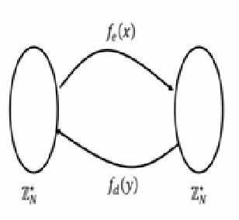
RSA permutation

Slide 7
Factoring Assumption

Slide 8
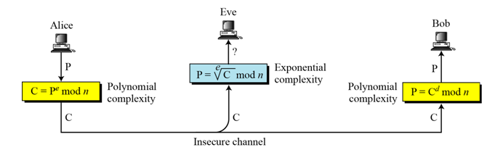
Complexity of operations in RSA

Slide 9
Key Generation Algorithm
1. Select two prime numbers P and Q
2. Compute n=P*Q
3. Compute φ Euler's totient function.
Φ(n) = (p-1)(q-1)
4. Select e such that gcd(e, φ (n))=1
5. Determine ‘d’ as d*e = 1 +k φ (n)
6. Cipher text C = M^e mod n where M is the
message M = C^d mod n

Slide 10
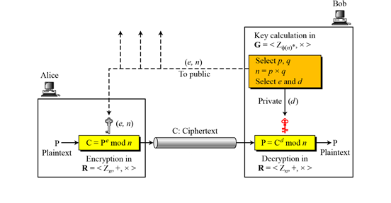
Procedure

Slide 11
Example-1
1. Take primes: p=5,q=11

Slide 12
Example-2
1. p=3 and q=5

Slide 13
Encryption/Decryption

Slide 14
Limitations
Not using small primes
Not using primes that are very close
Two people must not use the same N
Message should not be observable of eth power

Slide 15
Attacks against RSA
Brute Force
Try all possible keys
Mathematical Attacks
Factor n
Calculate Φ(n)
Timings Attacks
Use the running time of the algorithm to determine d, the decryption key
Protocol Attacks

Slide 16
Thank You!
Next Class
Mandatory reading for the next class
https://people.csail.mit.edu/rivest/Rsapaper.pdf

Slide 17


Vineetha B
Computer Science and Engineering
PES University, Bengaluru

